Slide 1
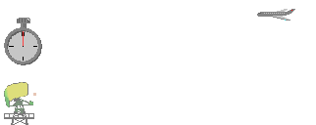
RADAR Signal Processing

Slide 2
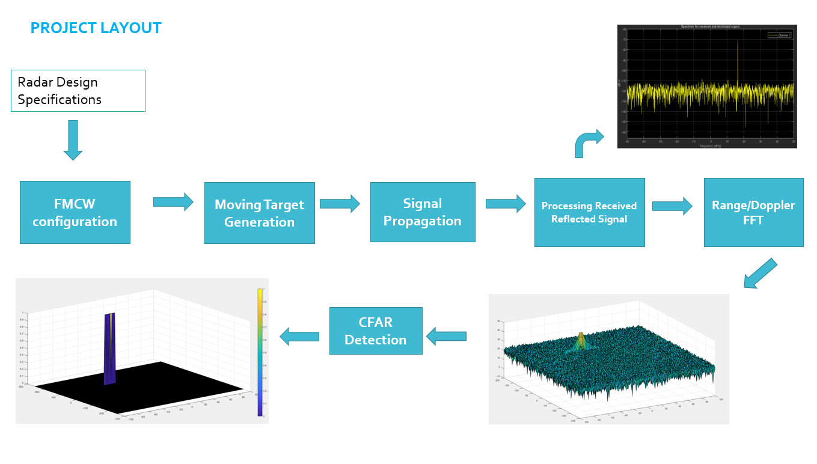
affects
Tx
Driving Scenario
Rx Signal
Range
Velocity

Slide 3
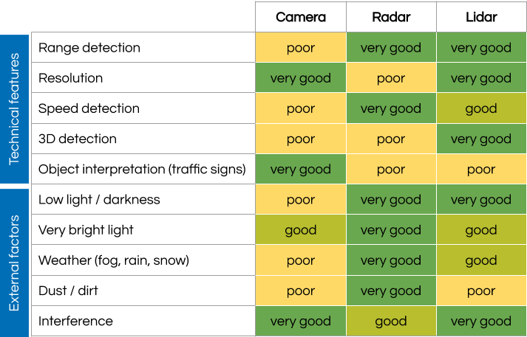
RADAR Cons

Slide 4
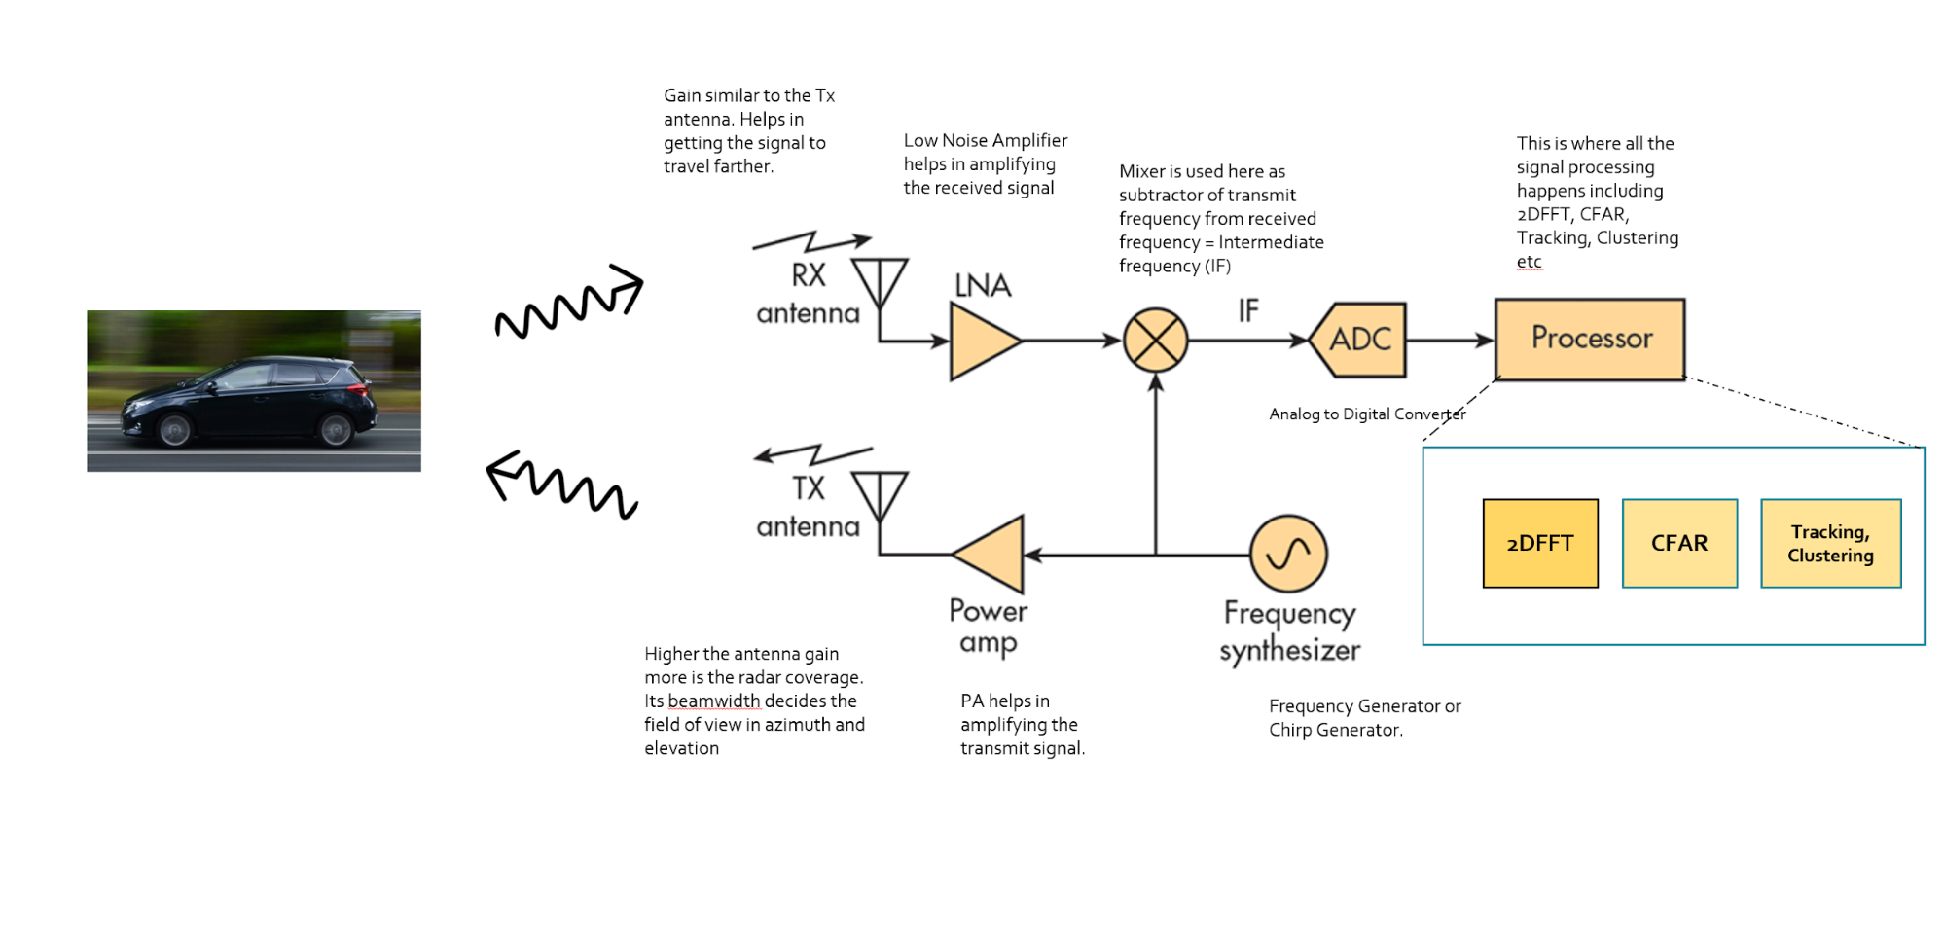
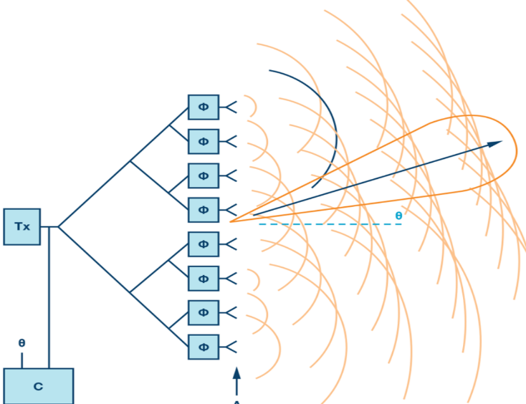
Basic Architecture of Radar System
Gain
Beam Steering → Angle of Arrival

Slide 5
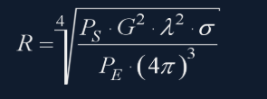
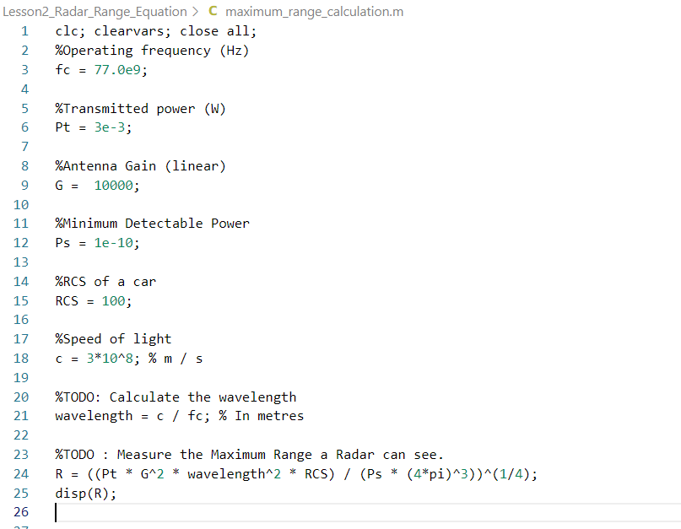
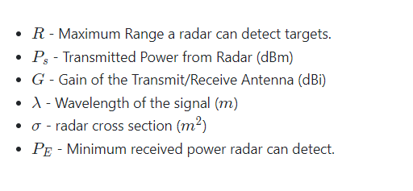
Maximum Radar Range Equation

Slide 6
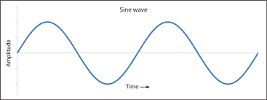
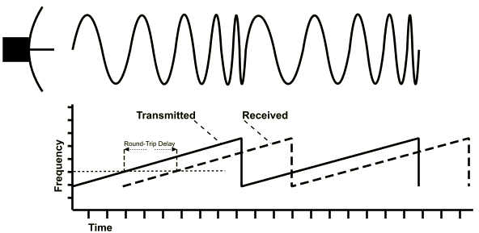
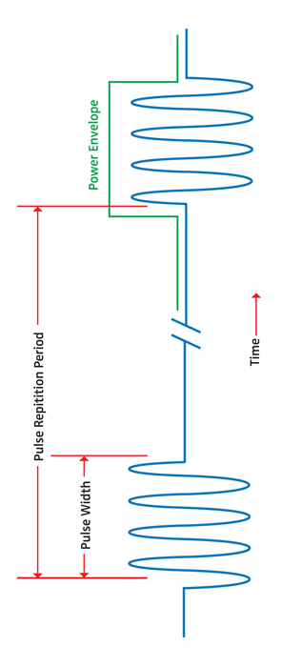
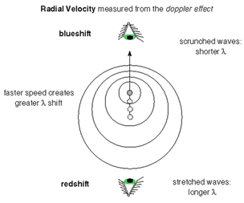
Radar Waveform Types
Pulses Continuous Wave Frequency Modulated C. W.[FMCW]

Slide 7
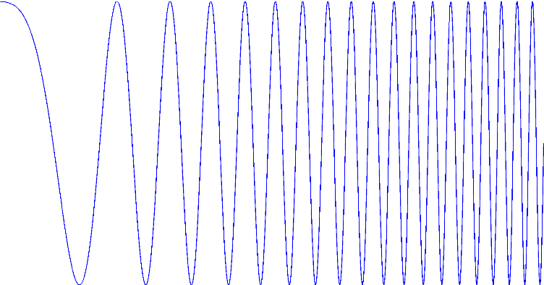
Principle of FMCW radar
frequency-modulated
continuous-wave
A radar transmitting a continuous carrier modulated by a periodic function such as a sinusoid or sawtooth wave to provide range data (IEEE Std. 686-2008).
Modulation is the keyword, since this adds the ranging capability to FMCW radars with respect to unmodulated CW radars.
We will concentrate in this talk on linear FMCW radar (LFMCW).
frequency
amplitude
f₀
time
up-chirp
time

Slide 8
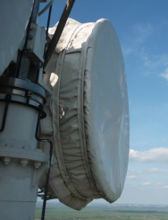
Single target
Radar
range R
frequency
frequency excursion, sweep bandwidth B_{sweep}
sweep time T_{s}
time

Slide 9
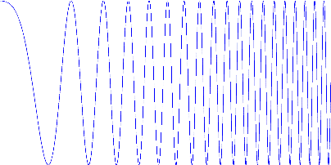
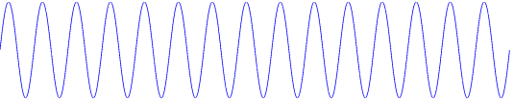
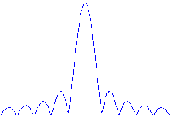
Single target
frequency
amplitude
Radar
f₀
time
range R
up-chirp
time
frequency
frequency excursion, sweep bandwidth B_{sweep}
beat frequency f_{b}
sweep time T_{s}
time
modulus of the spectrum
receiver output
Fourier
transformation
time
range
f_{b} frequency

Slide 10
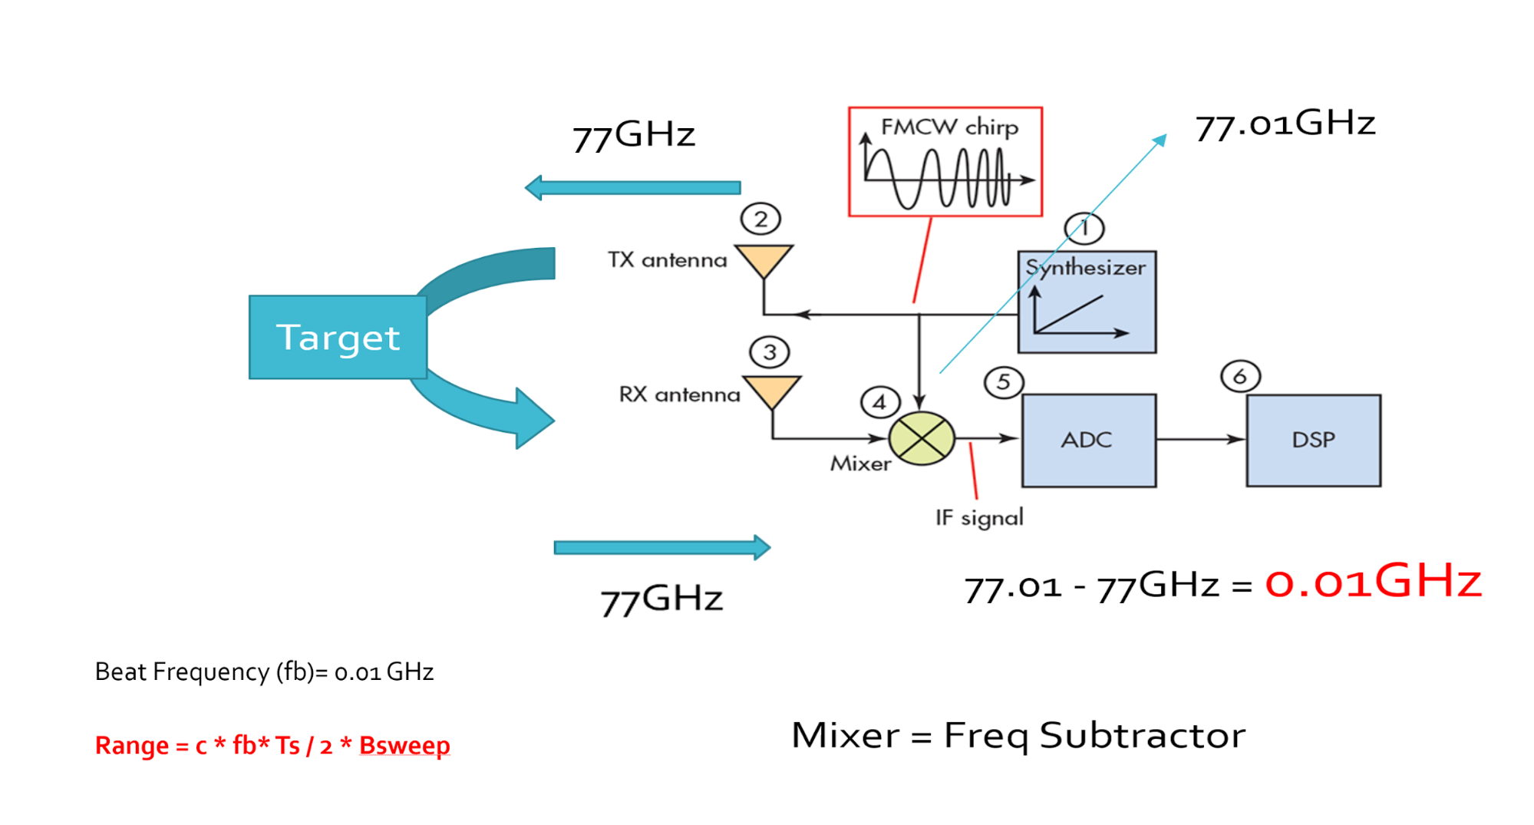
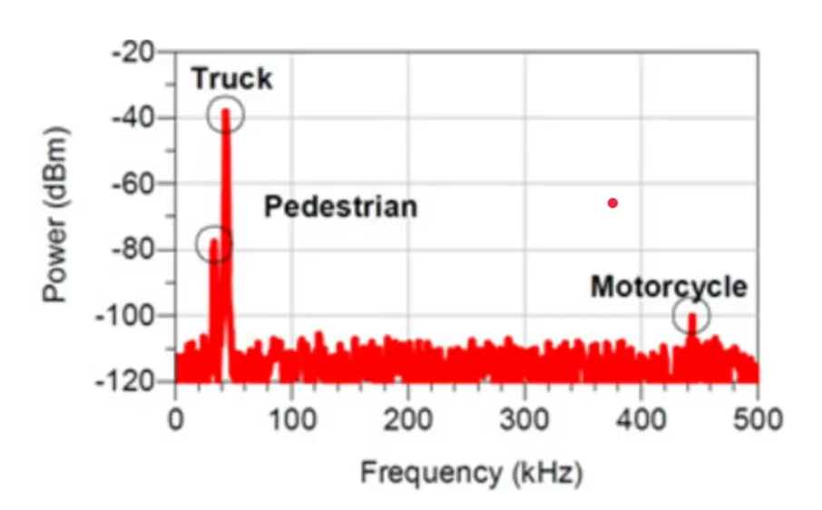
Radar Range Calculation

Slide 11
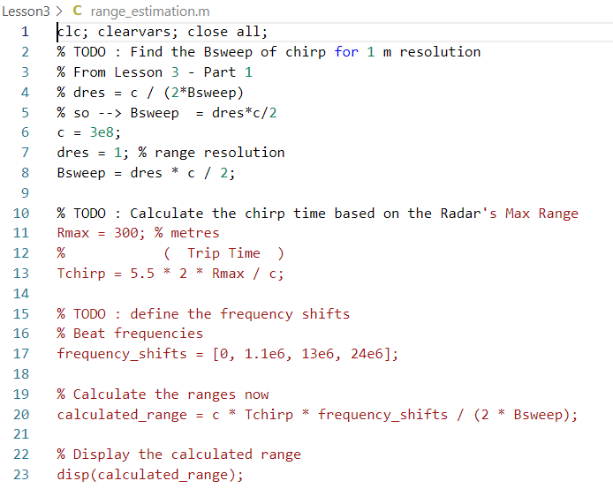
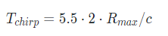
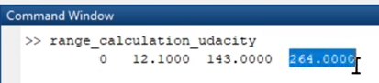
Range Estimation Exercise
Using the following MATLAB code sample, complete the TODOs to calculate the range in meters of four targets with respective measured beat frequencies [0 MHz, 1.1 MHz, 13 MHz, 24 MHz].
You can use the following parameter values:
The radar maximum range = 300m
The range resolution = 1m
The speed of light c = 3*10^8
Note : The sweep time can be computed based on the time needed for the signal to travel the maximum range. In general, for an FMCW radar system, the sweep time should be at least 5 to 6 times the round trip time. This example uses a factor of 5.5:

Slide 12
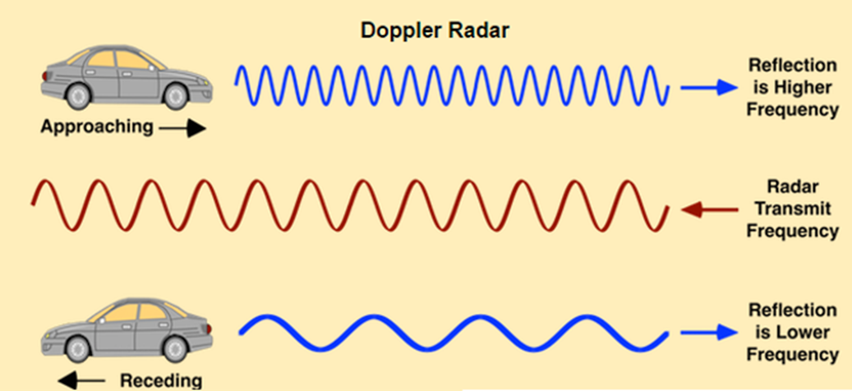
Velocity effect
A moving target induces a Doppler frequency shift
Radar
range R
with the radar wavelength λ.
frequency
sweep bandwidth B_{sweep}
beat frequency
f_{D}
time
sweep time T_{s}

Slide 13
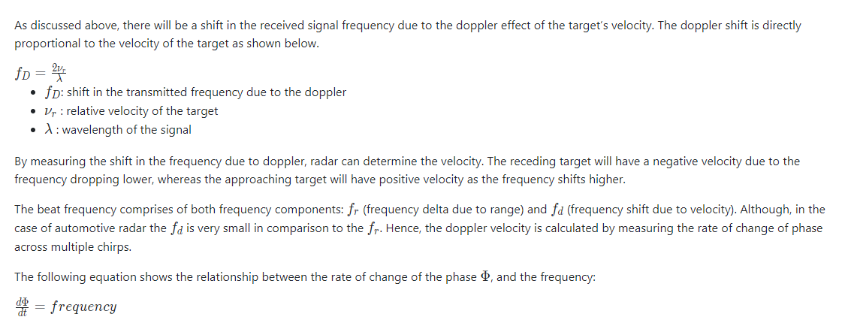
Doppler Estimation

Slide 14
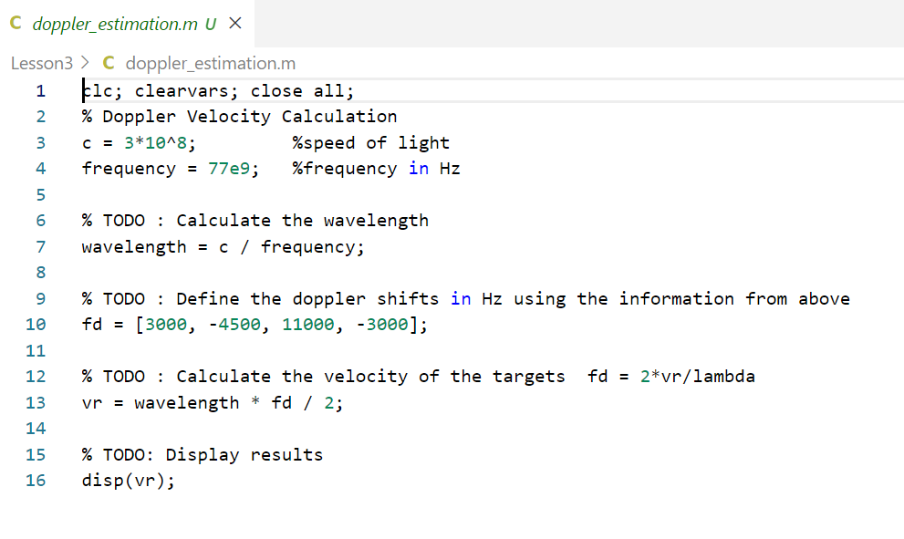
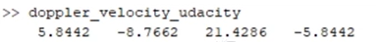
Doppler Estimation Exercise
Output

Slide 15
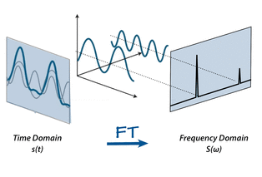
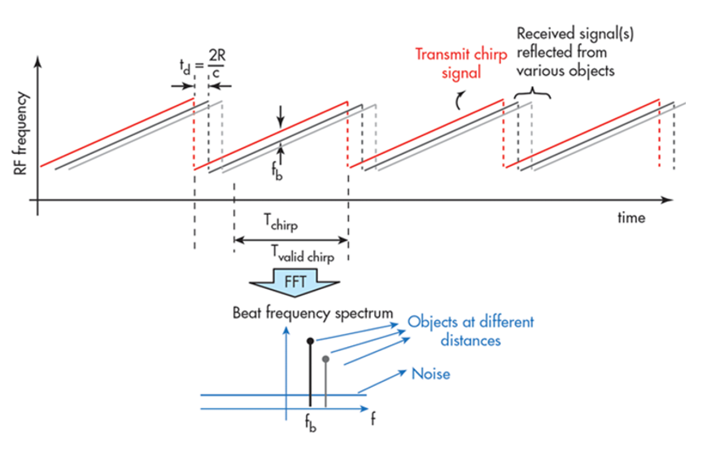
Fast Fourier Transform (FFT)

Slide 16
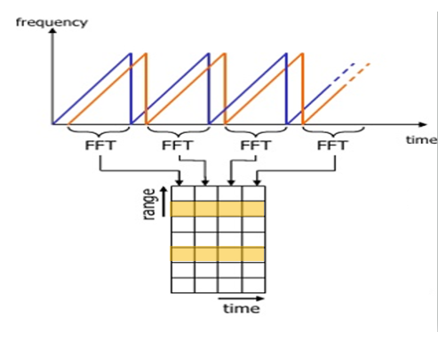
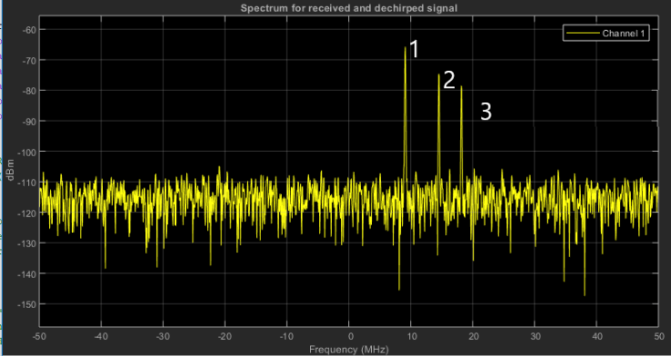
FFT bins Due to Doppler Shift
Each bin in every column of the block represents an increasing range value so that the end of the last bin represents the maximum range of a radar

Slide 17
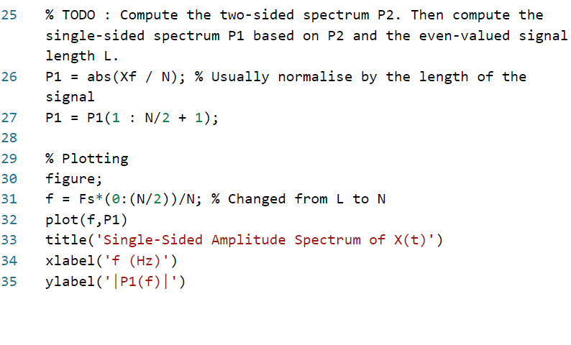
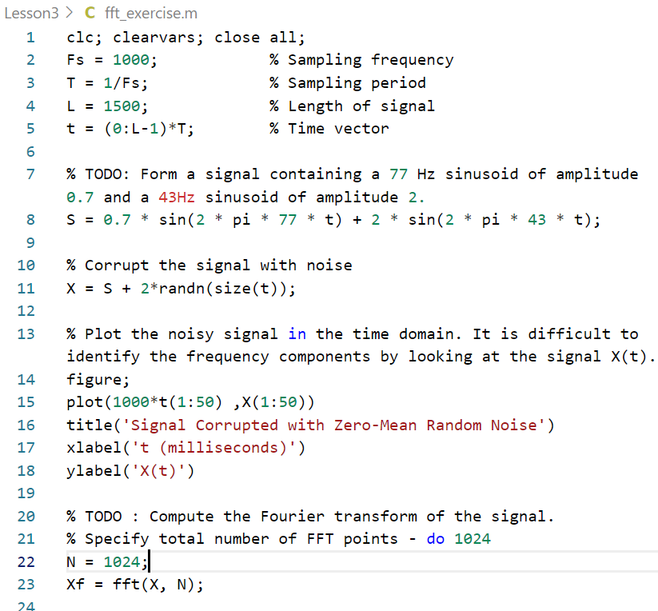
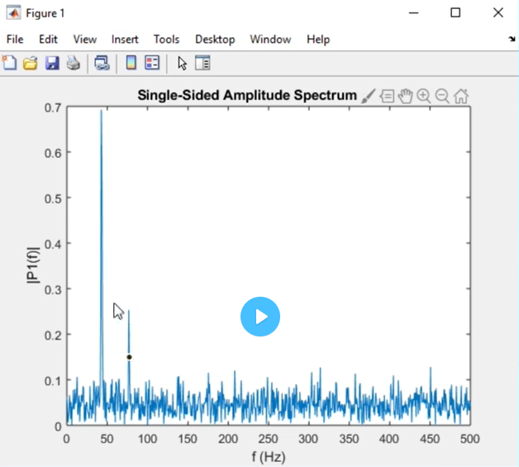

FFT Exercise

Slide 18
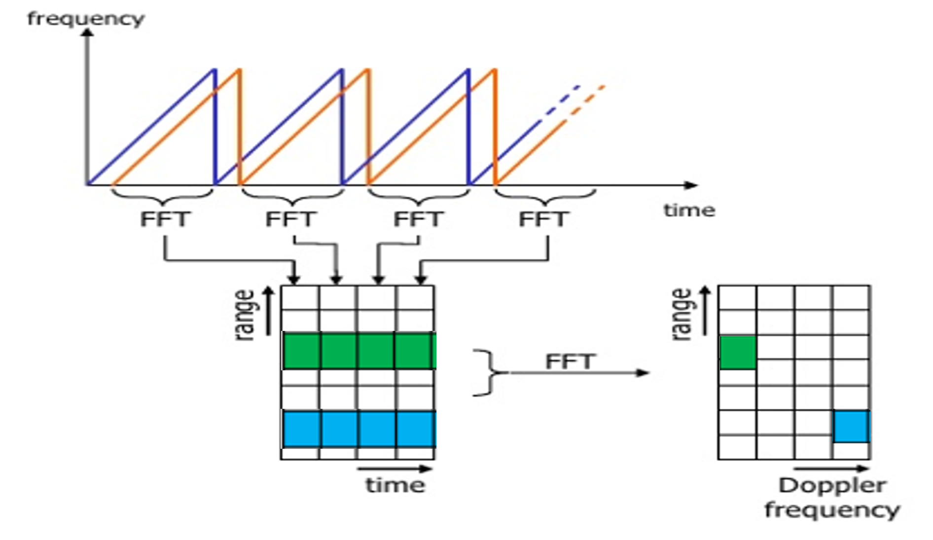
2D FFT (Proof: Radar Ambiguity Equation)

Slide 19
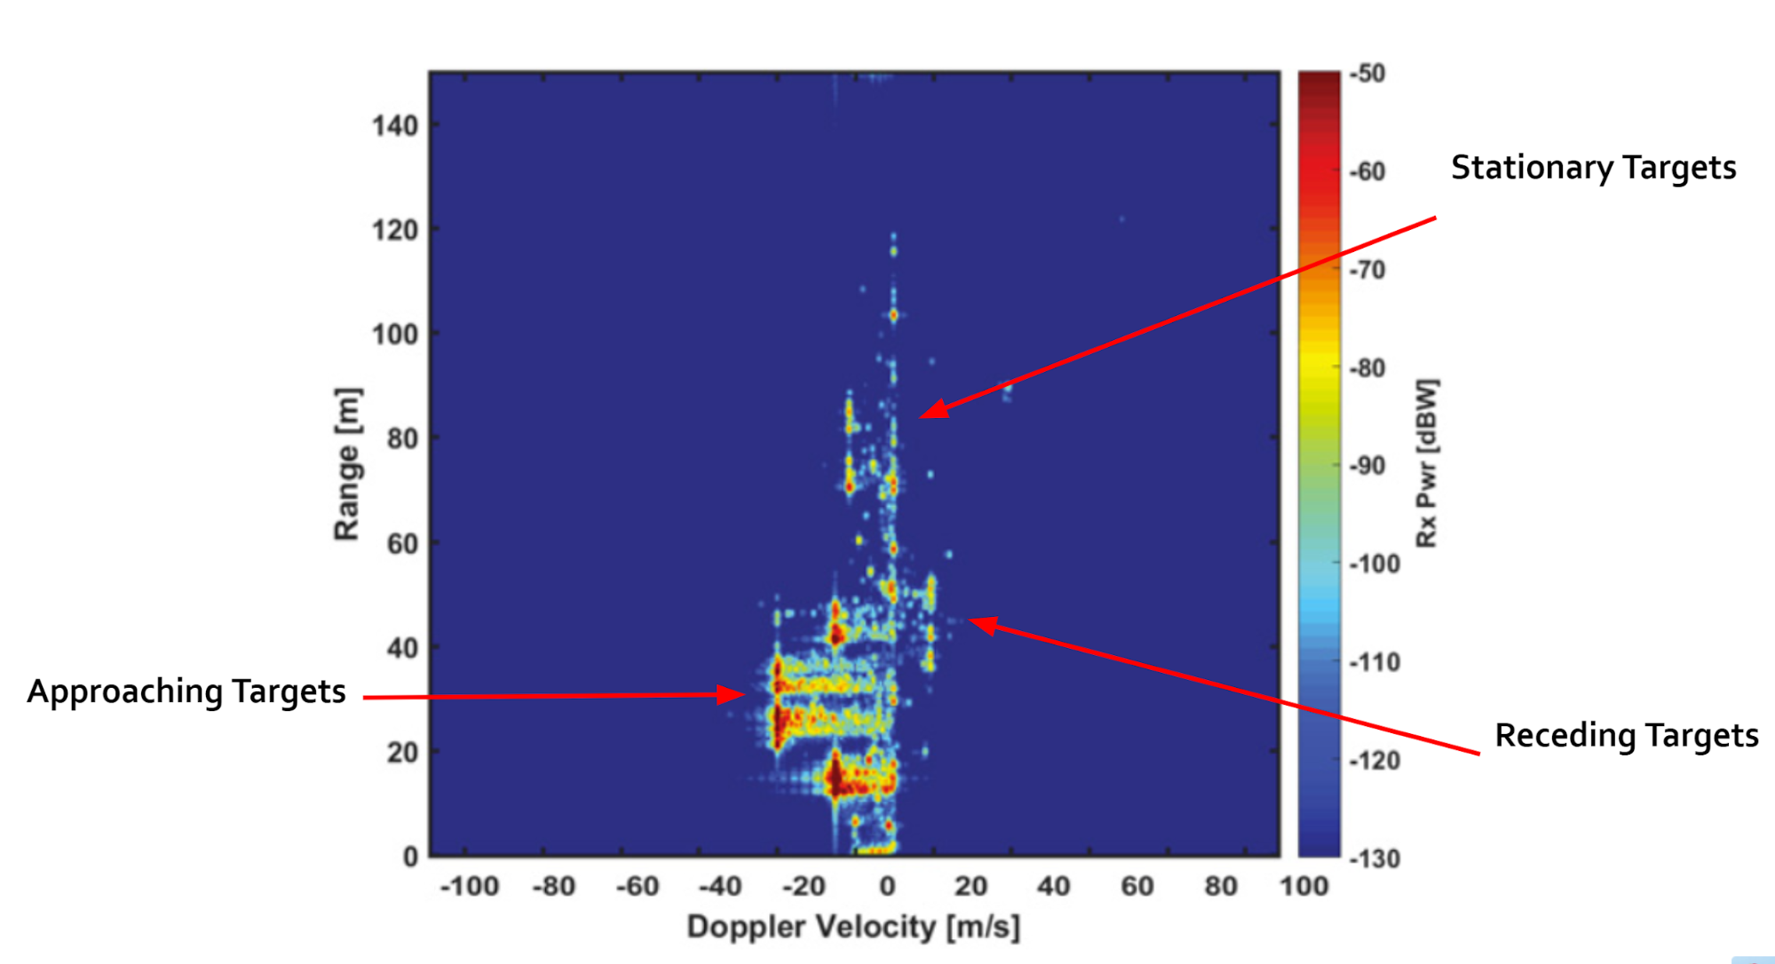
2D FFT (Proof: Radar Ambiguity Equation)

Slide 20
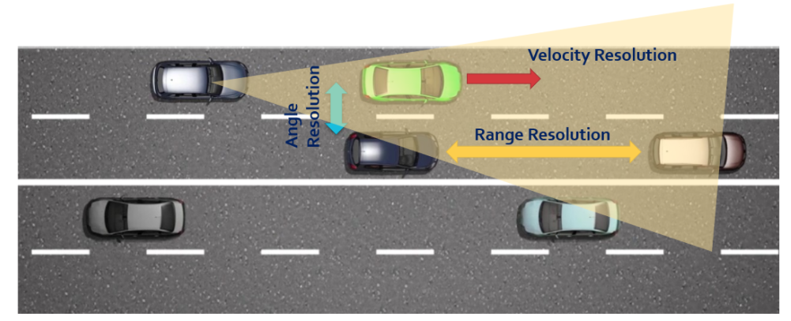
Resolving Targets

Slide 21
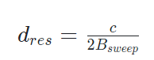
Resolving Targets (MultiTargets ??)(Proofs???)
The capability of a radar to resolve targets is very critical for an accurate perception.
Range Resolution: It is the capability of the radar to distinguish between two targets that are very close to each other in range. If a radar has range resolution of 4 meters then it cannot separate on range basis a pedestrian standing 1 m away from the car.
The range resolution is solely dependent on the bandwidth of the chirp Bsweep​:
Velocity Resolution: If two targets have the same range they can still be resolved if they are traveling at different velocities. The velocity resolution is dependent on the number of chirps. As discussed for our case we selected to send 128 chirps. A higher number of chirps increases the velocity resolution, but it also takes longer to process the signal.
Angle Resolution: Radar is capable of separating two targets spatially. If two targets are at similar range travelling at same velocities, then they can still be resolved based on their angle in radar coordinate system. Angle resolution depends on different parameters depending on the angle estimation technique used. We will cover this in more detail in the next lesson.

Slide 22
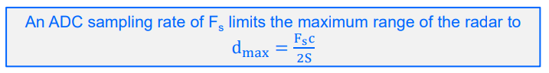
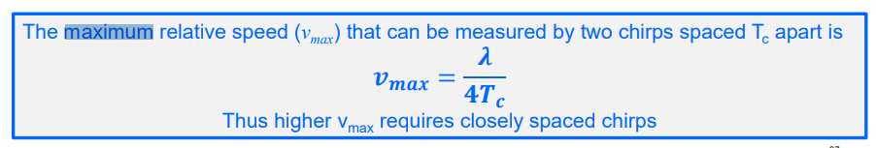
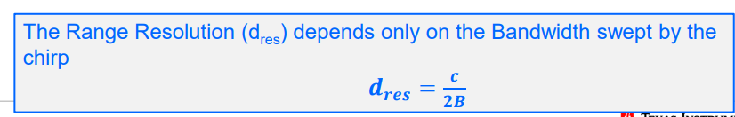
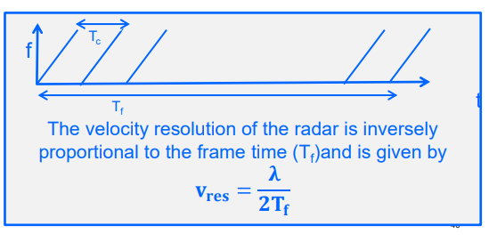
FMCW Radar Range and Radial Velocity
FinalRmax =
min (FMCW_Rmax, wavePropagation max dist.)
Slope = Bsweep/(Tchirp)

Slide 23
Radar System tradeoffs
Information Available from Radar
Mainly Range and Velocity with high accuracy/Confidence level.
Multi-target detection and tracking with the available frame rate.
Freq. Band
Sampling Rate
Bandwidth
Tradeoff
Range Resolution
Velocity Resolution
Complexity
HW
SW

Slide 24
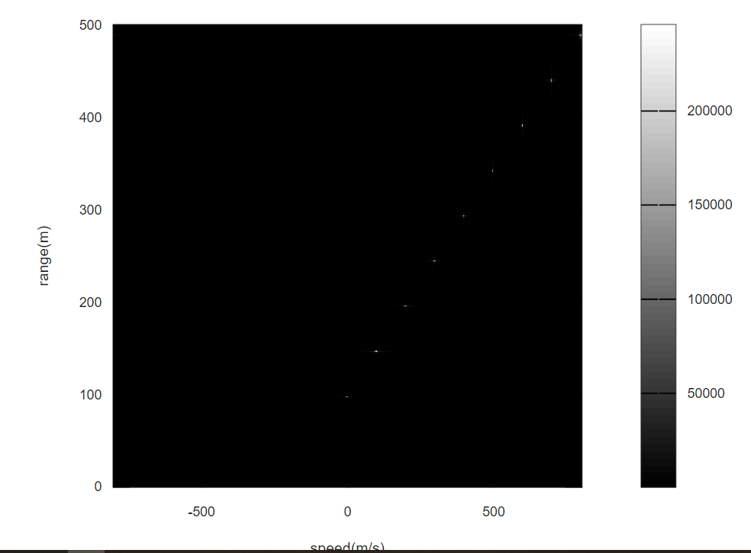
RangeDopplerMap
R=[100; 150; 200; 250; 300 ;350; 400; 450; 500]
V=[0; 100; 200; 300; 400; 500; 600; 700 ;800]

Slide 25
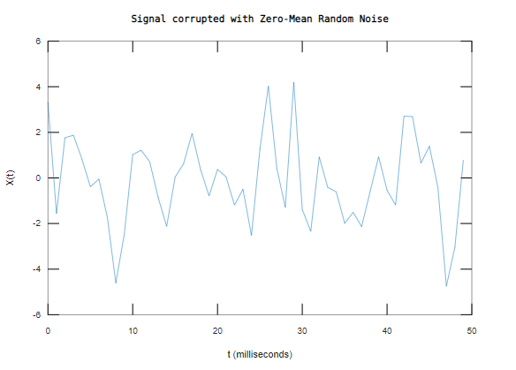
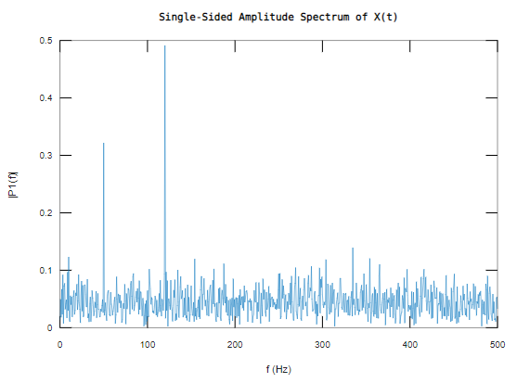
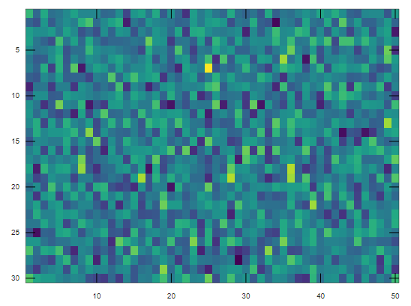
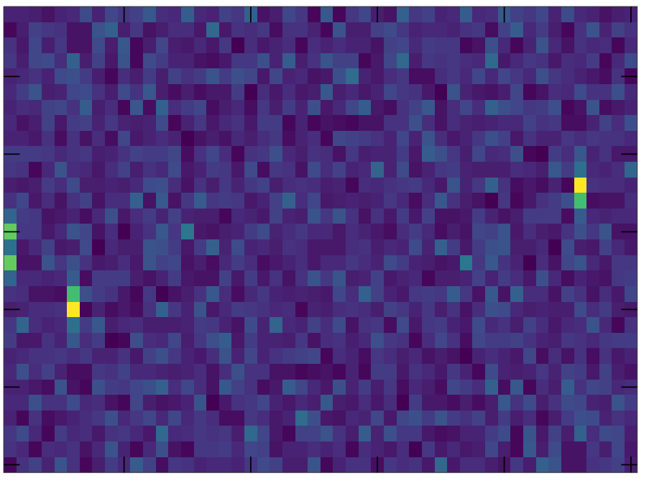
2D FFT Code: fft2_exercise_Matlab.m (skip)

Slide 26
2D FFT Exercise

Slide 27
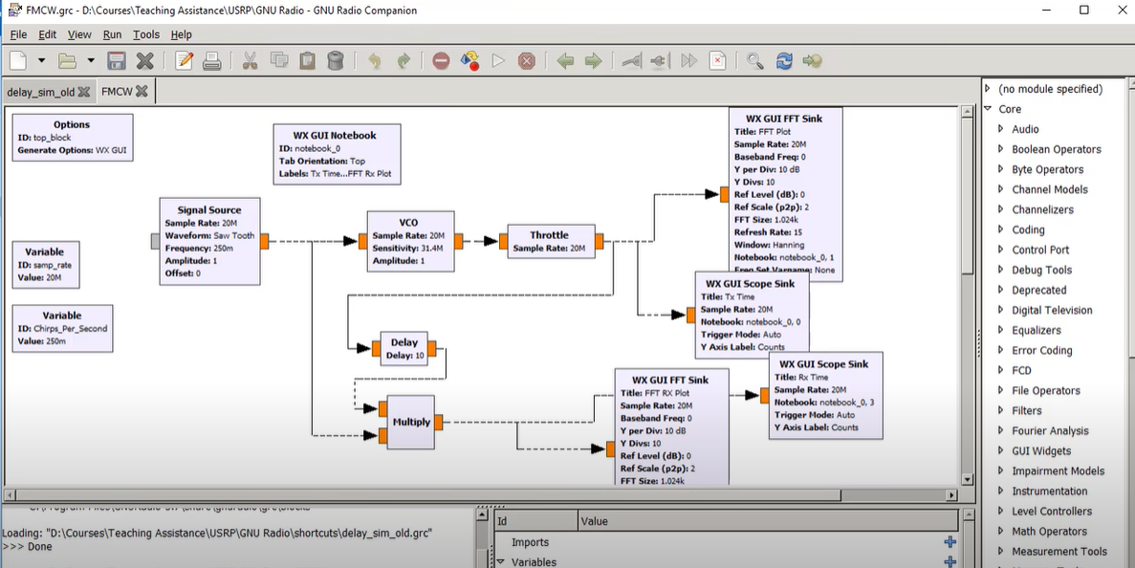
Supplementary Materials [Radar Lab]
https://www.youtube.com/watch?v=E7oLdquzyj4

Slide 28
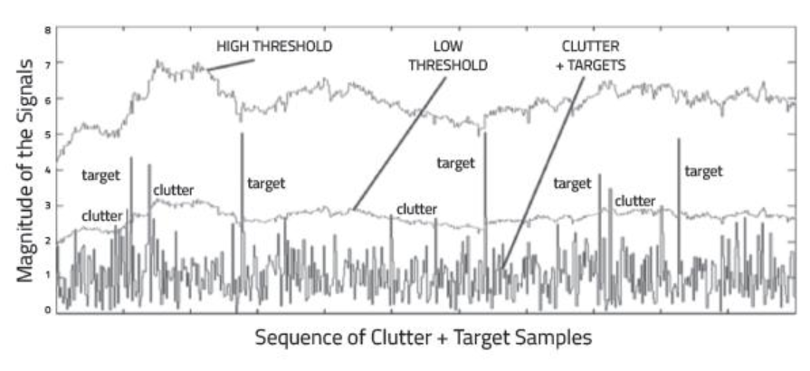
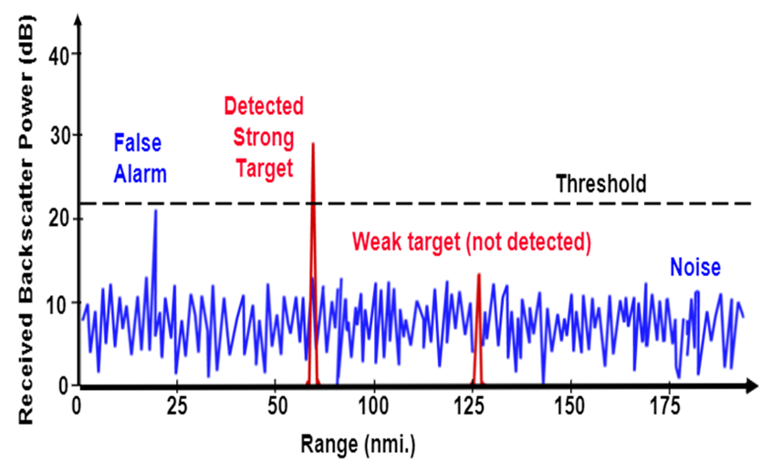
Clutter
Clutter Thresholding

Slide 29

Tesla Model S on Autopilot “Radar ?!”

Slide 30

Constant False Alarm Rate(CFAR)
There are multiple categories of CFAR:
Cell Averaging CFAR (CA-CFAR)
Ordered Statistics CFAR (OS CFAR)
Maximum Minimum Statistic (MAMIS CFAR)
And, multiple variants of CA-CFAR.
CFAR threshold

Slide 31
Constant False Alarm Rate(CFAR)
The false alarm issue can be resolved by implementing the constant false alarm rate. CFAR varies the detection threshold based on the vehicle surroundings.
The CFAR technique estimates the level of interference in radar range and doppler cells “Training Cells” on either or both the side of the “Cell Under Test”. The estimate is then used to decide if the target is in the Cell Under Test (CUT).
The process loops across all the range cells and decides the presence of target based on the noise estimate.
The basis of the process is that when noise is present, the cells around the cell of interest will contain a good estimate of the noise, i.e. it assumes that the noise or interference is spatially or temporarily homogeneous.
Theoretically it will produce a constant false alarm rate, which is independent of the noise or clutter level

Slide 32


Cell Averaging CFAR (CA-CFAR)
Sliding Window

Slide 33
Constant False Alarm Rate(CFAR)
CA-CFAR is the most commonly used CFAR detection technique. As seen in the previous lesson, the FFT blocks are generated on implementing range and doppler FFTs across the number of chirps. The CFAR process includes the sliding of a window across the cells in FFT blocks. Each window consists of the following cells.
Cell Under Test : The cell that is tested to detect the presence of the target by comparing the signal level against the noise estimate (threshold).
Training Cells : The level of noise is measured over the Training Cells. The Training Cells can be divided into two regions, the cells lagging the CUT, called lagging Training Cells and the cells leading the CUT, called Leading Training Cells. The noise is estimated by averaging the noise under the training cells. In some cases either leading or lagging cell average is taken, while in the other the leading and lagging cell average is combined and the higher of two is considered for noise level estimate.
The number of training cells should be decided based on the environment. If a dense traffic scenario then the fewer training cells should be used, as closely spaced targets can impact the noise estimate.
Guard Cells : The cells just next to CUT are assigned as Guard Cells. The purpose of the Guard Cells is to avoid the target signal from leaking into the training cells that could adversely affect the noise estimate. The number of guard cells should be decided based on the leakage of the target signal out of the cell under test. If target reflections are strong they often get into surrounding bins.
Threshold Factor (Offset) : Use an offset value to scale the noise threshold. If the signal strength is defined in logarithmic form then add this offset value to the average noise estimate, else multiply it.

Slide 34

CFAR 1D Implementation (code: ca_cfar.m)
The following steps here can be used to implement CFAR in the next MATLAB exercise. You can use the code template below to get started as well.
T : Number of Training Cells
G : Number of Guard Cells
N : Total number of Cells
Define the number of training cells and guard cells
Start sliding the window one cell at a time across the complete FFT 1D array. Total window size should be: 2(T+G)+CUT
For each step, sum the signal (noise) within all the leading or lagging training cells
Average the sum to determine the noise threshold
Using an appropriate offset value scale the threshold
Now, measure the signal in the CUT, which is T+G+1 from the window starting point
Compare the signal measured in 5 against the threshold measured in 4
If the level of signal measured in CUT is smaller than the threshold measured, then assign 0 value to the signal within CUT.

Slide 35

CFAR 2D

Slide 36
CFAR 2D
The following steps can be used to implement 2D-CFAR in MATLAB:
Determine the number of Training cells for each dimension Tr and Td. Similarly, pick the number of guard cells Gr and Gd.
Slide the Cell Under Test (CUT) across the complete cell matrix
Select the grid that includes the training, guard and test cells. Grid Size = (2Tr+2Gr+1)(2Td+2Gd+1).
The total number of cells in the guard region and cell under test. (2Gr+1)(2Gd+1).
This gives the Training Cells : (2Tr+2Gr+1)(2Td+2Gd+1) - (2Gr+1)(2Gd+1)
Measure and average the noise across all the training cells. This gives the threshold
Add the offset (if in signal strength in dB) to the threshold to keep the false alarm to the minimum.
Determine the signal level at the Cell Under Test.
If the CUT signal level is greater than the Threshold, assign a value of 1, else equate it to zero.
Since the cell under test are not located at the edges, due to the training cells occupying the edges, we suppress the edges to zero. Any cell value that is neither 1 nor a 0, assign it a zero.

Slide 37


Clustering

Slide 38
Clustering
 | P0 | P1 | P2 | P3 | P4 | P5 | …..
P0 | 0 | distance | distance | distance | distance | distance | distance
P1 | distance | 0 | distance | distance | distance | distance | distance
P2 | distance | distance | 0 | distance | distance | distance | distance
P3 | distance | distance | distance | 0 | distance | distance | distance
P4 | distance | distance | distance | distance | 0 | distance | distance
P5 | distance | distance | distance | distance | distance | 0 | distance
….. | distance | distance | distance | distance | distance | distance | 0
 | P0 | P1 | P2 | P3 | P4 | P5 | …..
P0 | Select Points with distances < vehicle size → group these detections and respective Radar measurements → compute mean → cluster ID → remove rows whose points present in the group points
P1 | …………….
P2 | …………….
P3 | …………….
P4 | …………….
P5 | …………….
….. | …………….

Slide 39

Clustering
The clustering implementation above uses the following steps:
If the detections are from the same sensor, then loop through every single detection point and measure the Euclidean distance between all of them.
Initialize a vector to hold the detection clusters.

Slide 40

Clustering
1
2
3
4
5
6
7
8
Keep running the loop until the detection list is empty.
Pick the first detection in the checklist and check for its clustering neighbors.
If the distance between the first pick and remaining detections is less than the vehicle size
Then group those detections and their respective radar sensor measurements, including range and velocity.
For the group, take the mean of the range and velocity measurements.
Note: the radar measurement vector has 6 values - where range and velocity for x and y coordinates reside at indices 1,2, 4, and 5: [x, y, -, Vx, Vy, -]
Create a new Cluster ID. Then, assign all the group detections to the same ID.
Further, assign cluster, the mean range, and velocity.
In the end, delete from the list the detections which have already been assigned to a cluster.
Keep repeating the process until the detection list is empty.

Slide 41
affects
Tx
Driving Scenario
Rx Signal
Range
Velocity

